Slide 1
AB Lietuvos paštas
Product owner
Mapping the Future: Smart Post Kiosk 24/7 Overview in Estonia
AB Lietuvos paštas - Product owner Vadim Kööp +372 53811395
Tallinn 2024

Slide 2
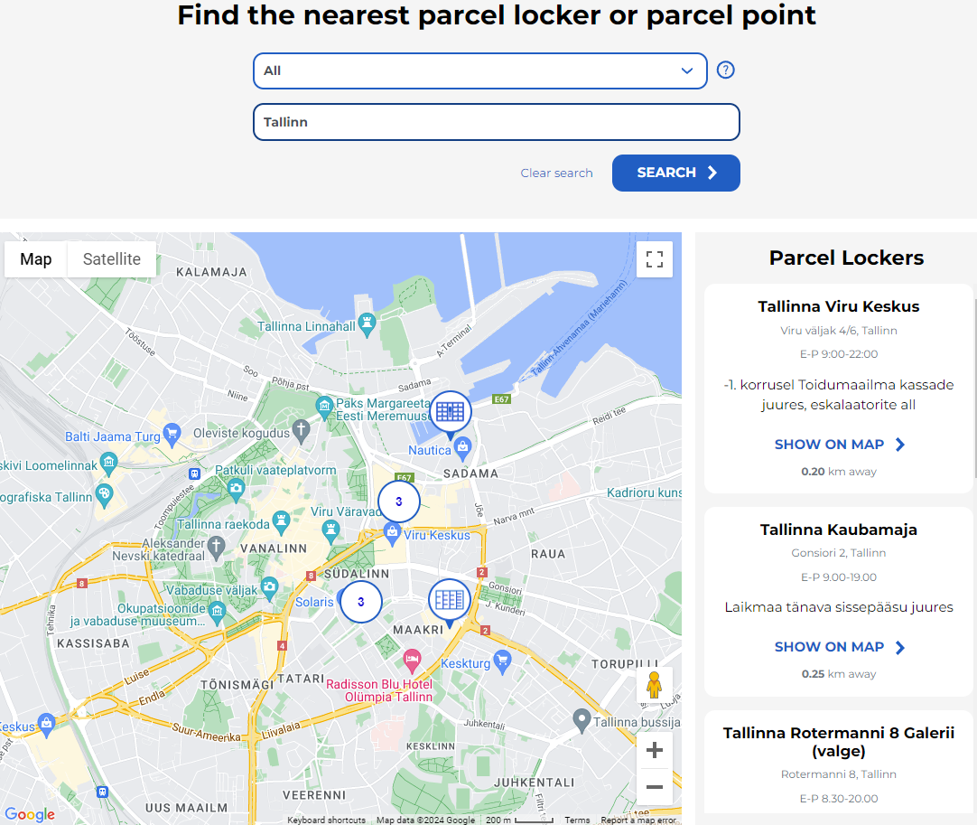
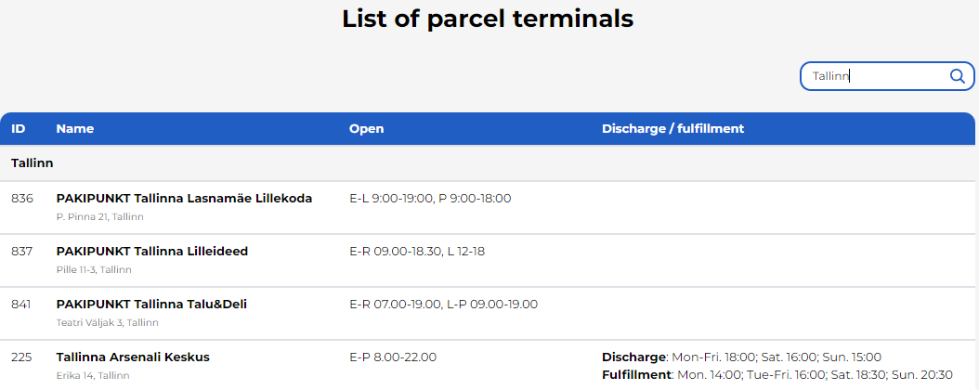
Map overview
Key cities:
a. Tallinn ~394,024 population (Capital City) - 20 machines.
b. Tartu ~101,092 population (Second-Largest City) - 10 machines.
c. Narva ~ 66,980 population - 7 machines.
d. Kohtla-Järve ~ 46,060 population - 5 machines.
e. Pärnu ~ 44,192 population - 5 machines.
f. Viljandi ~ 20,309 population - 4 machines.
g. Rakvere ~ 16,736 population - 4 machines.
h. Sillamaee ~ 16,672 population - 4 machines.
i. Maardu ~ 16,630 population - 3 machines.
j. Kuressaare ~ 14,921 population - 6 machines.
k. Voru ~ 14,631 population - 3 machines.
l. Valga ~ 13,945 population - 3 machines.
m. Haapsalu ~ 11,805 population - 3 machines.
n. Jõhvi ~ 11,469 population - 3 machines.
o. Other towns (distributed) - 20 machines.
Reference:
Itella smartpost self-service. [Online] https://itella.ee/eraklient/pakiautomaatide-asukohad - (Accessed 05.02.2024)
Population of Cities in Estonia 2024. [Online] https://worldpopulationreview.com/countries/cities/estonia - (Accessed 17.01.2024)

Slide 3
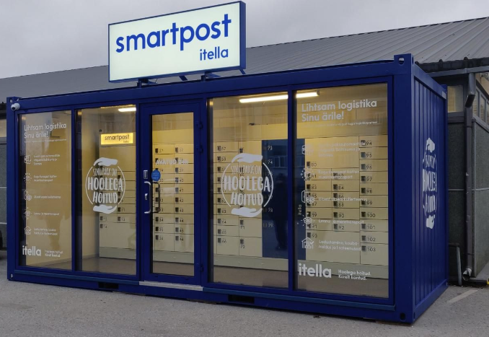
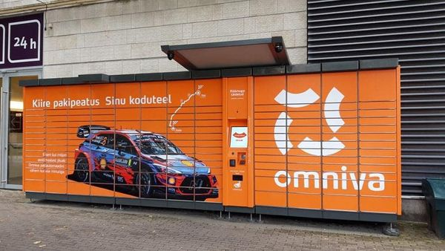
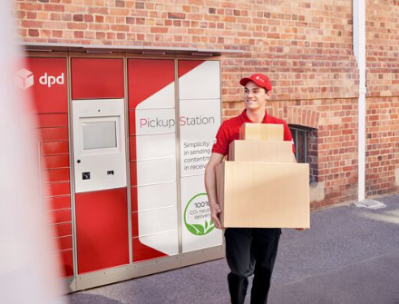
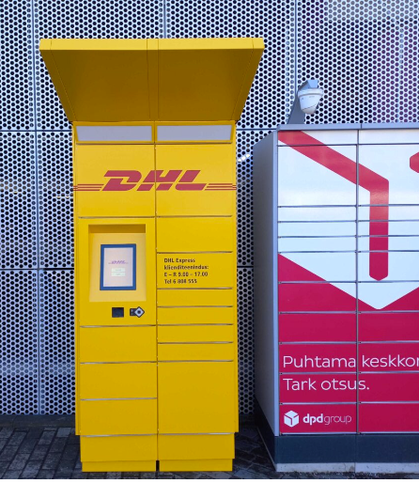
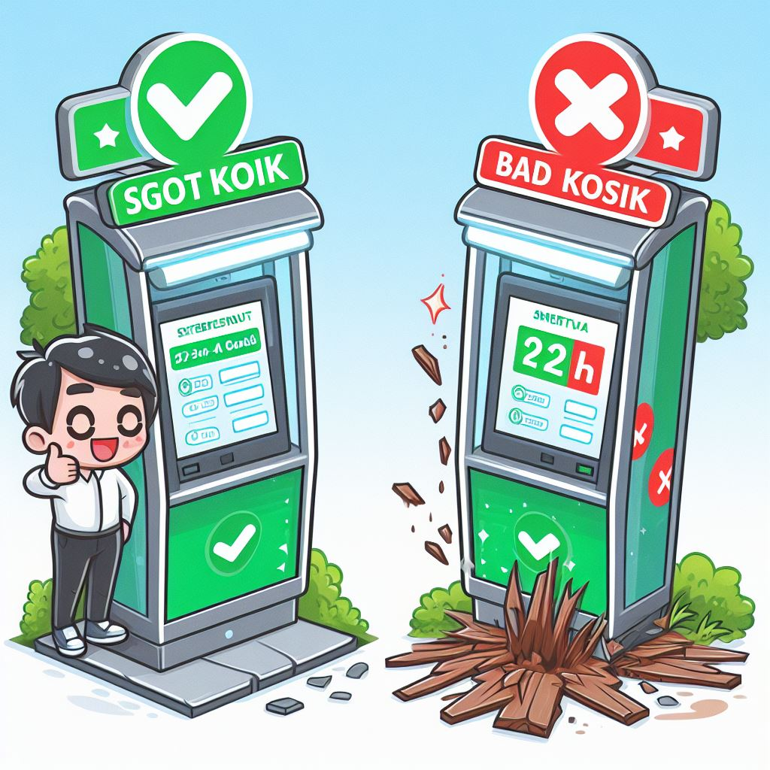

Location types
TÜRI Grossi Itella smartpost
Magistral Omniva smartpost
Types of Locations:
a. Residential Areas
b. Business Districts
c. Shopping Centers/Malls
d. Busy Commercial Streets
e. Transportation Hubs (Train/Bus Stations)
DPD smartpost
Ülimiste DHL smartpost
Example of good and bad smart kiosk
Weather conditions and environment

Slide 4
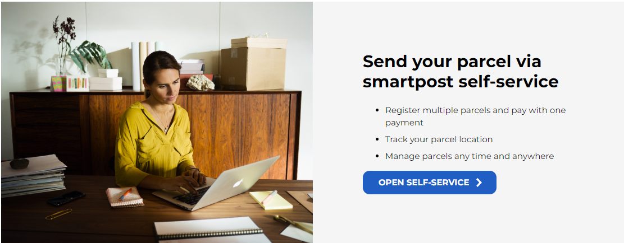
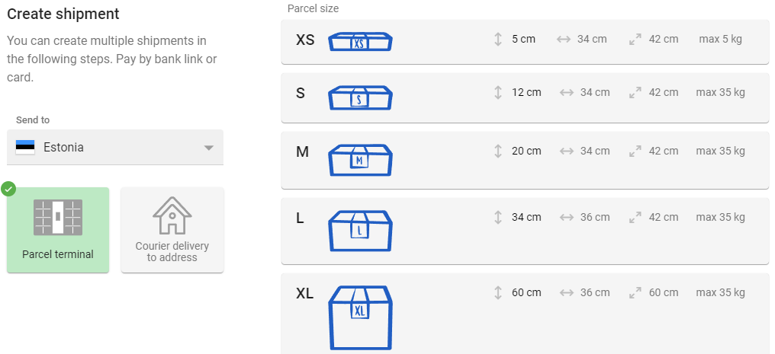
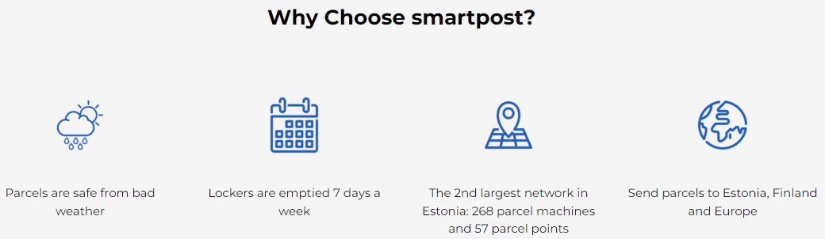
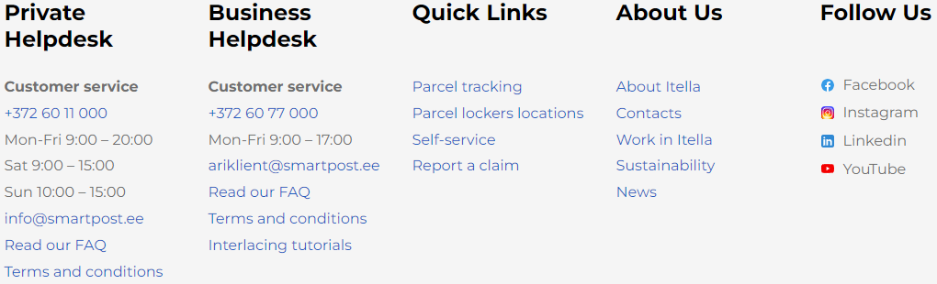
Impact and Benefits
Main principles and criteria for 24/7 postal kiosks:
24/7 Accessibility: Smartpost kiosks are available round the clock for users to send and receive mail at their convenience.
User-Friendly Interface: They feature a simple and intuitive interface for easy operations like sending, receiving, and payment.
Security: Kiosks ensure the security of parcels through measures such as video surveillance and electronic locks.
Parcel Tracking: Users can track the status of their parcels for real-time information on their location and status.
Diverse Services: Kiosks may offer various services like sending and receiving parcels, bill payment, stamp sales, etc .
Convenient Locations: Strategically placed in public areas like malls, train stations, and airports for easy access.
Technical Support: Users have access to technical support for assistance with issues or queries.
Reference: Itella smartpost self-service. [Online] https://itella.ee/eraklient/pakiautomaatide-asukohad - (Accessed 05.02.2024)

Slide 5


